Slide 1
Revolutionizing E-Commerce: eBizTech's Ambitious Platform Upgrade

Slide 2
Agenda
Background
Methodologies and Tools
Project Management Challenges
Risk Management Strategies
Data-Driven Decisions
Customer-Centric Approaches
AI Integration and Ethical Considerations
Summary

Slide 3
Background

Slide 4
Background
EBizTech: A leading technology company specializing in e-commerce solutions, is embarking on a transformative journey to upgrade its e-commerce platform.
Goal: Create a cutting-edge e-commerce platform that exceeds customer expectations.
User-Centric Design
Personalized and intuitive shopping experience.
Design driven by customer behavior and usability principles.
Technology Advancements
AI and machine learning for better recommendations.
Data analytics for optimized inventory.
Enhanced User Engagement
Chatbots for real-time support.
Social shopping features.
Scalability and Performance
High-performance architecture.
Support rapid growth and transaction volumes.

Slide 5
Methodologies and Tools

Slide 6
Project Management Methods
Waterfall
Agile
Every part of the project must be completed before the next segment begins.
Change within a project cycle can be very difficult.
Customer engagement at the front of the project and at the end during deployment.
Late-stage risks can disrupt the flow.
Break the project down into smaller segments and strives for adaptability.
New features need to be added; it can be done easily within the next sprint.
User feedback throughout the cycle.
Risk is handled periodically with each sprint.

Slide 7
Human Centered Design
Aligning methodologies and tools with what users need.
Understand the customer at a base level.
Broken down into three main parts:
Research and Empathy: understand the day-to-day of a customer/user and how the product fits.
Define Needs and Requirements: solutions are developed to address the needs or gaps that customers/users currently have.
Prototyping and Testing: confirmation that solutions that have been developed do meet the needs.

Slide 8
AI Tools
Jira Automation - automate repetitive tasks like notifying your quality and testing teams.
Tempo.io - overview of your projects, allowing for more efficient resource allocation.
Machine Learning Models – analysis of historical project data as well as real-time IoT analysis (predictive analytics).

Slide 9
Impact on PM Role
Goals shift from milestones to 2–4 week goal targets.
Elimination of work silos and communication barriers as sprints force communication between stakeholders.
Shortening overall project timelines.
Higher potential for scope creep with iterative cycles.
Potential for resistance to buy in of new methodologies.

Slide 10
Project Management Challenges

Slide 11

Background
EBizTech is integrating AI into core systems.
Personalized shopping recommendations.
Create better search capabilities on the platform.
Use predictive analytics for inventory management.
Additional automations for core processes.
Project is experiencing scope creep.
Driven by the mobile development for iOS and Android.
Notes:
As I mentioned EBizTech is undergoing the integration of AI into its core systems to achieve personalized shopping recommendations, improve the search capabilities on their platform, use predictive analytics for inventory management, as well as create additional automations for their core processes. Currently the project is experiencing scope creep due to the mobile development for iOS and Android.

Slide 12
Assessing Existing Processes
Why assessment is needed
Need to understand the current process to incorporate automation.
To determine risk points and bottlenecks.
Don’t want to automate for sake of automation.
Mapping Method
Use a process map to map out the current process to highlight bottlenecks.
Involve key stakeholders for their perspective.
This mapping will determine the path forward and tools used for the new CI/CD pipeline.

Slide 13
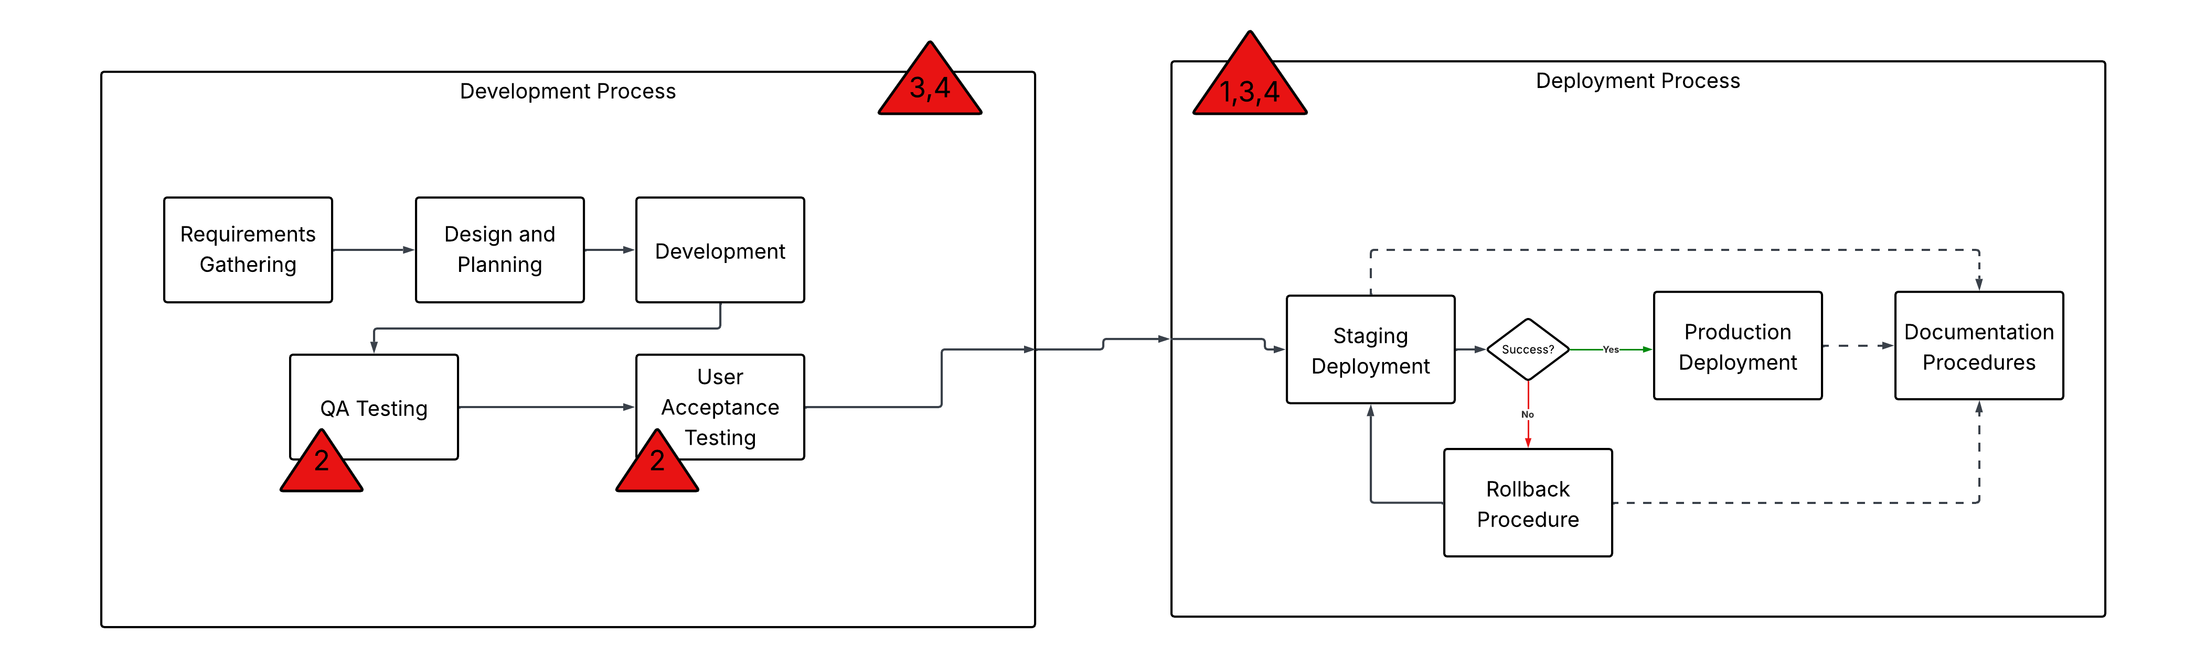
Assessing Existing Processes
Very manual deployment process which leads to delays and human error.
No automation in the testing process.
Both development and deployment are resource heavy.
Little to no visibility throughout the development and deployment processes.

Slide 14
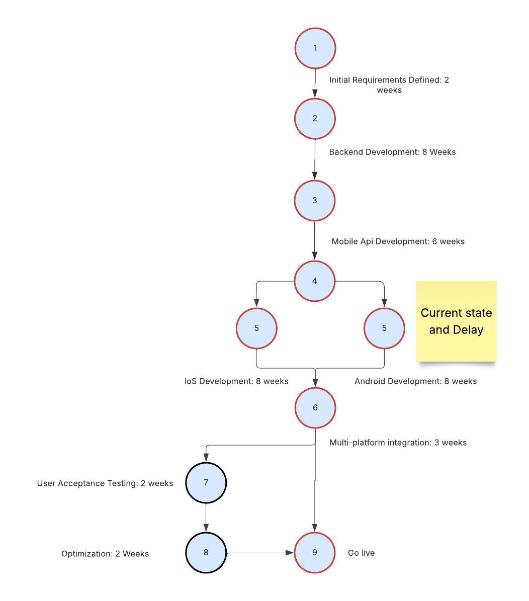
The Critical Path
Current timeline delays come from the mobile app development.
Multiplatform integration becomes a bottleneck to the critical path with the delays that are currently being experienced.
Plan directly addresses these issues and allows the project to flow through the critical path.

Slide 15

Identifying Automation Opportunities
Where to Automate | What to Automate
Code Builds | Automate the code build after it is pushed out.
Testing | Automate the QA and UA testing in the development flow. Unit Tests Integration Tests
Deployment | Automate the steps from staging to production including the rollback process.
Infrastructure | Implement infrastructure as code to automate provisioning of infrastructure as needed.
Why Automation?
To help eliminate or reduce the identified bottlenecks in the process.
Frees up human resources to focus on other tasks.
Reduces human error for critical tasks.
Speeds up development and deployment time.

Slide 16
Benefits of CI/CD
Increase in quality as bugs are caught early and often.
Increase in time to market as many labor-intensive manual steps become automated.
Reduces overall project risk as deployments are consistent as well as infrastructure provisioning.
Increases resources as people have more time to do other tasks.

Slide 17




Selecting CI/CD Technologies and Tools
Tool | Criteria | Info
GitLab |  | Version control tool that allows for easy access and visibility into the project and where its at for any point in the dev cycle.
Jenkins |  | Open-Sourced CI/CD server that allows for automation of delivery pipeline.
Docker |  | Allows software to come with consistent environments for running, eliminating the need to create environments in the CI/CD pipeline.
Kubernetes |  | Automates the deployment of the containers from docker.
Infrastructure as Code |  | Allows infrastructure to be automatically provisioned for project needs. Also creates consistent infrastructure environments for projects.
Criteria
Current Tech Stack Compatibility: Want a seamless integration between new tools and current infrastructure.
Scalability: As projects and teams increase, new tools need to be able to accommodate without becoming bottlenecks themselves.
Support: Want tools that have runtime and proven track records of success to ease implementation and ensure ongoing updates.
Complexity: Tools need to be a good mix of easily adaptable and learnable but also can fit the current bottlenecks and needs.
All tools listed have these in varying degrees, but the table highlights where each tool really shines.

Slide 18

Ensuring Compatibility
Capability Issues
Failure in the pipeline due to different environments.
Different server configurations lead to working on dev machines but not in staging environment.
Lack of capability can introduce bugs and increase build and deployment times.
Mitigation
Infrastructure as Code (IaC): standardizes the environments
Containers ensure the code is created in identical environments.
Automated roll back procedure to speed up bug identification and removal.
Dashboards in Gitlab and Jenkins provide quick overviews of the projects, making it easy to see additional delays and bottlenecks.
Having your CI/CD tools be compatible with your stack ensures efficiency and eliminates potential errors.
One less variable to deal with.

Slide 19
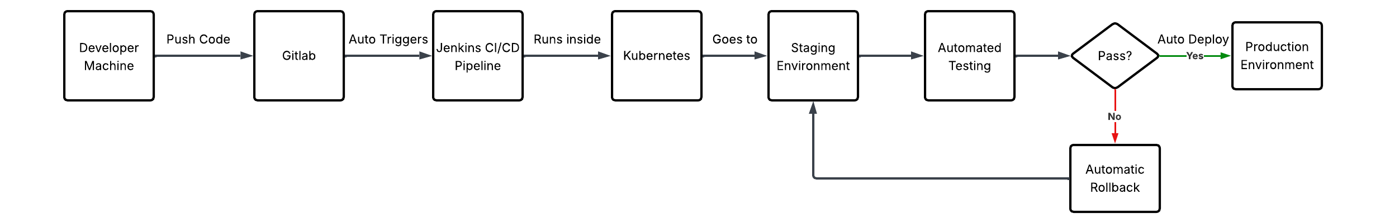
Process Mapping
Version control would be handled by Gitlab.
Provides visibility into the different parts of code that are being worked on.
Jenkins installed either in a docker container or on a server to act as the CI/CD pipeline.
Have separate containers for staging and production inside Kubernetes.
QA and UA tests also reside within the staging container.
This infrastructure will be deployed using IaC, so it is consistent and repeatable throughout this and other projects.

Slide 20
Risk Management Strategies

Slide 21

Introduction
Risk is always involved and can be detrimental to project success.
Integrating AI introduces several risks.
Main risks are data privacy, algorithm behavior, and Integration complexities with the legacy system.
Plan identifies, analyzes, mitigates, and monitors risks.
Create stability, user trust, and compliance.
Notes:
EBizTech is integrating AI into its e-commerce platform. Risk is always involved with projects and can be detrimental to success. Integrating AI introduces several risks such as data privacy, algorithm behavior, and Integration complexities with the legacy system. Our risk plan identifies, analyzes, mitigates, and monitors risks to create stability, user trust, and compliance.

Slide 22
Risk Identification
Scope creep is an issue for most projects.
The requirements and features of a project expand without adding additional time or resources.
Implementation of Delphi Method is recommended.
Allows engagement from all key stakeholders in the project to anonymously answer questions and identify risks within the project.
Steps: Defining the problem, assemble a panel of experts and key stakeholders, participate in an anonymous survey to provide their feedback, initial responses are gathered and put to the panel for questioning, repeat until risks are identified.

Slide 23
Risk Identification
Expert Interviews with key stakeholders.
AI engineers, security, software engineers, mobile developers, compliance.
Historical project data reviews.
Past projects highlight scope creep when mobile development is involved.
Risk assessment workshops were conducted.
Brainstorming of risks collectively with key stakeholders.
Industry frameworks were consulted.
NIST AI Risk Management Framework & IBM AI Risk Management.
Central repository of risks in risk register.
Notes:
Risk identification happened in several ways as shown here. The key elements were to involve all the key stakeholders, review historical data, and utilize established industry frameworks for risk. This identification strategy leads us to a holistic view of risk in this project.

Slide 24
Top Three Risks
Data Privacy
Large volume of customer data is required.
Mismanagement leads to loss of customer trust, regulatory fines and violations, and overall harm to the reputation of the company.
Algorithm Behavior
Sometimes produce strange or inaccurate results.
Lead to disruptions in service among other negatives.
Integration Complexity
Can be compatibility issues with legacy systems.
Lead to delays in implementation.
Notes:
These three risks are the most critical and need to be mitigated immediately. We will show later where they fall on the risk matrix to validate this claim. They have the potential to disrupt production, create a loss of trust in our customers, and open the company up to fines from the government and other regulatory bodies.

Slide 25
Risk Management Approach
Based on the NIST AI Risk Management Framework.
Includes Probability-Impact Matrix for prioritization.
Continuous monitoring and documentation elements.
Early identification and assessment of risks.
Proactive and ongoing mitigation efforts.
Notes:
The risk management approach has 5 elements to it and is based on the NIST AI Risk Management Framework and IBM’s AI Risk guidelines. This should allow us to be proactive instead of reactive with our risk management.

Slide 26
Risk Qualification and Prioritization
Probability-Impact Matrix used to score risks.
Higher scores determine higher prioritization and resource allocation.
Highest scorers were data privacy, algorithm behavior, and integration complexity.
These risks require immediate mitigation.
Harm customer trust, violate compliance laws, delay project timelines, amplify current scope creep issues.
Notes:
This concept helps provide concrete reasoning for the prioritization of risks. The three top risks were all AI related and ones we called out earlier in this presentation.

Slide 27
Probability-Impact Matrix
Probability: 1 = very low, 5 = Very High
Impact: 1 = None, 5 = Critical
Risk Score = Probability x Impact
Risk # | Risk | Probability | Impact | Score
R1 | Data Privacy | 5 | 5 | 25
R2 | Algorithm Behavior | 4 | 5 | 20
R3 | Integration Complexity | 4 | 4 | 16
R4 | Scope Creep | 4 | 3 | 12
R5 | Data Quality | 3 | 4 | 12
R6 | Bloated Platform | 3 | 4 | 12
R7 | Developer Burnout | 4 | 3 | 12
R8 | Security Vulnerabilities | 2 | 5 | 10
R9 | Model Drift | 3 | 3 | 9
R10 | Over Budget | 4 | 2 | 8
R11 | Stakeholder Confusion | 2 | 3 | 6
Notes:
Here is our matrix to identify and quantify which risks are the most important. On the next slide there is a color coded visual to reinforce this information.

Slide 28
Probability-Impact Matrix
R1 - Data Privacy has the highest risk.
R2 - Algorithm Behavior, R3 - Integration Complexity ,R4 - Scope Creep, R5 - Data Quality, R6 - Bloated Platform, R7 – Developer Burnout are also high.
Impact / Probability | 1 (Very Low) | 2 (Low) | 3 (Medium) | 4 (High) | 5 (Very High)
5 (Critical) | 5 | 10 (R8) | 15 | 20 (R2) | 25 (R1)
4 (Major) | 4 | 8 (R10) | 12 (R4,R7) | 16 (R3) | 20
3 (Medium) | 3 | 6 (R11) | 9 (R9) | 12 (R5,R6) | 15
2 (Low) | 2 | 4 | 6 | 8 | 10
1 (None) | 1 | 2 | 3 | 4 | 5
Notes:
Our dark red category (critical risk) has values >15. The orange section has risk values of 10-15. The yellow section is for risks >=5 but <10. The green section is <5.

Slide 29
Monitoring and Review
Continuously monitoring and reviewing risks is critical to project success.
Projects evolve and change over time and with that so do the risks.
Risk register is the solution – provides a living document of project risks.
Priority shifts, new risks, development cycle all present a new risk profile.
Risk ID | Risk Description | Risk Category | Likelihood | Impact | Risk Owner | Identification Date | Risk Trigger | Current Status | Mitigation Plan | Contingency Plan | Risk Review Date

Slide 30
Risk Monitoring
Highest priority risks added to project tasks.
Risk managers are assigned to each risk.
Responsible for monitoring and actions.
Bi-weekly status updates to be implemented.
Creation of automation dashboards for AI models (accuracy, drift) and security.
Continuous review of risk register as new risks appear in the project.
Notes:
There are 5 sections to our risk monitoring. They include aspects of ownership, continuous review, and adding high priority risks as tasks within project sprints to be completed. This will provide accountability and visibility to the project and stakeholders.

Slide 31
Risk Mitigation
Privacy By Design principles to be added.
AI explainability and bias detection models.
Increased frequency of integration testing and earlier in the timeline.
Change Control processes to be added.
Additional data quality management techniques.
Notes:
These mitigation steps are derived from industry best practices from NIST, IBM, Standford and SentinelOne. We want each critical risk to have set steps for mitigation and direct ownership from an individual or group.

Slide 32
Risk ID | Title | Description | Category | Probability | Impact | Score | Mitigation | Owner | Status
R1 | Data Privacy | Mismanagement leads to loss of customer trust, regulatory fines and violations, and overall harm to the reputation of the company. | Privacy | 5 | 5 | 25 | Privacy By Design, enforce encryption, access controls, and data minimization. | Data Officer | Open
R2 | Algorithm Behavior | Sometimes produce strange or inaccurate results. | Technical | 4 | 5 | 20 | Implement explainability and interpretability models, perform bias assessments and create validation checkpoints, human-in-the-loop | ML Engineering Team | Open
R3 | Integration Complexity | Can be compatibility issues with legacy systems. | Technical | 4 | 4 | 16 | Perform integration testing early and often, Ensure data quality and combability before model deployment, leverage APIs and middleware | Systems team | Open
R4 | Scope Creep |  | Project | 4 | 3 | 12 |  | Project Manager | Open
R5 | Data Quality |  | Data | 3 | 4 | 12 |  | Data Engineers | Open
R6 | Bloated Platform |  | Project | 3 | 4 | 12 |  | Project Manager | Open
R7 | Developer Burnout |  | Project | 4 | 3 | 12 |  | Project Manager | Open
R8 | Security Vulnerabilities |  | Cybersecurity | 2 | 5 | 10 |  | Security Team | Open
R9 | Model Drift |  | Operations | 3 | 3 | 9 |  | ML Engineering Team | Open
R10 | Overbudget |  | Project | 4 | 2 | 8 |  | Project Manager | Open
R11 | Stakeholder Confusion |  | Organizational | 2 | 3 | 6 |  | Business Analyst | Open
Notes:
This slide shows our risk register, with our top three risks fully fleshed out with the mitigation strategies in place. This needs to be a living document that is constantly reviewed and updated throughout the rest of the project to ensure that our risks are appropriately handled.

Slide 33
Data Driven Decisions

Slide 34
Data-Driven Solutions
Why? Will merge the facts, metrics, and data with the design thinking methodology to create solutions that align with the overall goals of the business.
Change control board: Help limit the scope creep, which is the underlying problem of the decline in customer metrics.
Features that are requested to be added must have data accompanying them to prove their usefulness.
Reduce the load of current resources, which should directly affect the response times and stability of the site.
Implement AI to assist in customer support: Should reduce the amount of surface level support requests for the team.
Phased approach of implementing a chatbot and creating a FAQ of common questions and issues.
Decrease the response time and increase the CES and CSAT metrics.
Creating a sub team: Focuses on critical customer pain points.
Directly combat the U-shaped customer satisfaction effect.
Map the most common user journeys and work on/ implement fixes that lie within those processes.
Should increase the CES score, which should have a positive effect on all the other customer centric metrics.

Slide 35
Customer Centric Approaches

Slide 36
Current Project Status
User Feedback
Project Metrics
CSAT: 4.2/5
Conversion Rate: 10%
The website that is designed is very good from a customer perspective.
SPI: 0.95
Currently 5% behind schedule.
Scope Creep: additional features have put the project behind the original timeline.
Refocus to get the project back on track.

Slide 37
Customer Centric Metrics
Qualitative
Customers appreciate the user-friendly interface but express concerns about response times.
Customers struggle navigating certain features, while others want more frequent product updates and enhancements.
Quantitative
Month | Customer Satisfaction Score (CSAT) | Net Promoter Score (NPS) | Customer Effort Score (CES) | Retention Rate | Churn Rate | Average Response Time (Customer Support)
1 | 4.2/5 | NPS – 25 (Promoters: 30%, Passives: 40%, Detractors: 30%) | 3.8/5 | 70% | 15% | 30 (s)
2 | 4.3/5 | NPS – 26 (Promoters: 32%, Passives: 38%, Detractors: 30%) | 4.0/5 | 68% | 17% | 35 (s)
3 (current) | 4.0/5 | NPS – 24 (Promoters: 29%, Passives: 42%, Detractors: 29%) | 3.7/5 | 65% | 20% | 40 (s)

Slide 38
CCM Analysis
CSAT trended upward from month 1 to month 2, then dropped below the month-1 value to 4.0.
NPS shows a similar pattern: the current value (24) is lower than month 1 (25).
Within the NPS breakdown:
Promoters (loyal customers) decreased.
Passives (merely satisfied users) increased.
Higher initial satisfaction scores can decline when complexity or significant change is introduced.
The percentage of detractors remained unchanged, suggesting an underlying issue that has not been properly addressed.
Retention and customer churn data over the past 3 months show an alarming trend.
Churn rate has increased by 5% during this period.
Retention rate has decreased by 5% over the same timeframe.
The e-commerce site is struggling to retain its customer base.
Retention rates reflect the viability of a product or service.
5% drop in retention over 3 months is not sustainable for the business.

Slide 39
CCM Analysis
Average response time has steadily increased over the 3-month period, reaching 40 seconds.
This rise indicates another issue with the platform.
Qualitative feedback supports this concern:
“Customers appreciate the user-friendly interface but express concerns about response times from the customer support team.”
Longer wait times are likely contributing to declines in both CES and CSAT.
Customer Effort Score (CES) is currently at its lowest point in the time frame: 3.7/5.
A higher CES indicates an easier, more seamless customer experience.
The decrease aligns with qualitative customer feedback:
“Some customers struggle navigating certain features.”
This lower score shows the experience is not as seamless as intended and contributes to declines in other customer-centric metrics.

Slide 40
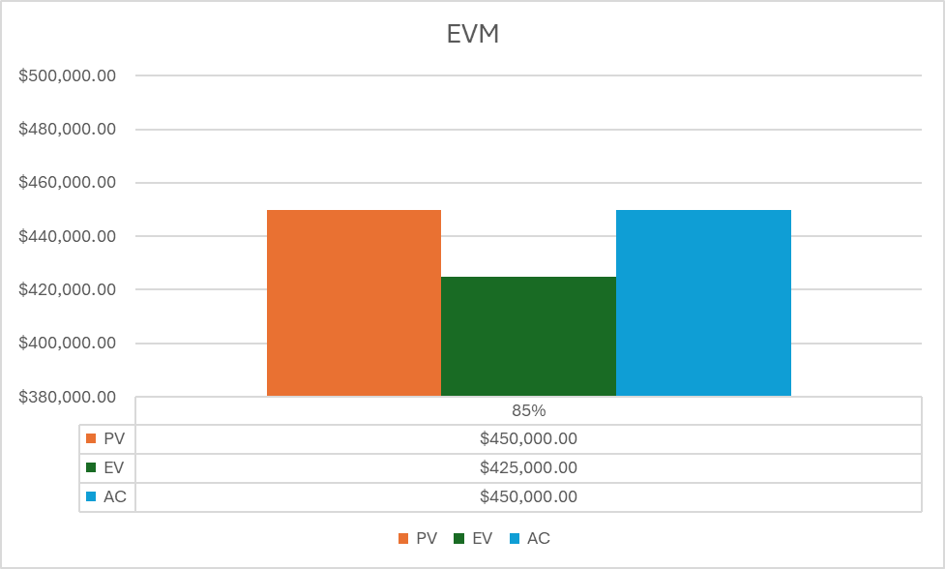
The Metrics
SPI:0.95
CPI:1.05
EV: $425,000
PV: $450,000
AC: $450,000
SV: -$25,000
CV: -$25,000
At this point, the project is behind schedule, but costs are being controlled well.

Slide 41

Concerning Areas
Customers are frustrated by response times and are finding using the site increasingly difficult.
Leading to the churn rate increasing.
Customers shifting from promoters to passives and detractors.
Creates a loop of customers requiring more support putting more stress on the project.
Customer loyalty and retention: NPS decreasing and churn rate increasing, the project is not engaging, creating, or retaining new users to the platform.
Customer support: the response time increase = direct correlation with the frustration of the customer base and the decrease of key customer centric metrics.
Customer effort: platform is becoming more complex for users to use.
Additional features have been added due to the scope creep of the project.
Notes:
These areas of concern are all affected by and a result of the current scope creep of the project, which in turn is affecting the reliability of our customer centric metrics. The development team is being consumed by the current bottleneck of the mobile deployment and taking focus away from the performance of the current implementation of the platform. This increase of scope is maxing out the team, causing additional dips in the quality of the product.

Slide 42
Design Thinking Approach
Empathize: Project team puts themselves in the customer’s shoes to understand their wants and needs.
Additional features are complex and not easy to use, coupled with extended support times make up the bulk of the frustration.
Site also does not stand out enough from the others.
Define: Take the findings from the empathize step and turn them into clear problem statements.
Customers need a better system to get simple questions answered.
Customers need to feel the reliability of the platform and new features need to add value to the experience.
Customers need an easier path to the things that they are looking for on the platform.
Notes:
The first stage is the empathize stage where the project team puts themselves in the customer’s shoes in an effort to understand their wants and needs. Doing this gives us an idea of the customer’s mindset. Based on the metrics above, customers are frustrated with the platform. Additional features are complex and not easy to use, coupled with extended support times make up the bulk of the frustration. The site also does not stand out enough from the others, which is validated by the percentage of passives in the NPS.

Slide 43

Design Thinking Approach
Ideate: Where ideas are brainstormed to solve the problem statements that were created in the previous step.
Features could be added like AI support, or a better FAQ section that assists customers with common surface level questions.
Getting more direct feedback like the qualitative results and including them in the design / sprint cycle coupled with a customer loyalty plan.
Journey map could be used and implemented that documented the interactions between customers and the site.

Slide 44

Design Thinking Approach
Prototype: The best ideas get created to validate their impact and value.
AI support: creating a minimum viable product for a chatbot that can answer the most common questions that the support team has gotten in the most recent month.
Journey map: using existing customer data to determine a base interaction map as well as shortest and longest paths to the target information that a customer is seeking.
Creation of a change control team to limit the feature requests and prioritize them will help with the whiplash of constant UX updates.

Slide 45

Design Thinking Approach
Test: Where the prototypes are implemented in temporary conditions or shortened timeframes.
Chatbot: it will be deployed to a small percentage of the users and tracked based on how many questions it takes away from the support team.
Change control process: will be implemented for 2 months, and the metric will be driven by feedback from the development team as well as any improvement to the customer centric metrics.
Journey mapping: will be led by a team that will be created to focus on customer pain points. They will create fixes to the items that they discover from the mapping process.

Slide 46
AI integration and Ethical Considerations

Slide 47
R1 – Data Privacy
Privacy By Design methodology - Organization
Enforce encryption, access controls, and data minimization – Security Team
Up the frequency of data audits – Data Officer
Design AI models with privacy in mind – ML Engineer
Resources needed: Compliance software, legal team, training
Steps: Map all data flows that integrate with AI, Classify and label data appropriately, implement at rest and in transit encryption, validate compliance with legal team for requirements.
Notes:
Al algorithms require customer data for training. This will require us to ensure that the data is used ethically but also protected. The steps listed here should ensure that this is the case.

Slide 48
R2 – Algorithm Behavior
Implement explainability and interpretability models – ML Engineers
Perform bias assessments and create validation checkpoints – Quality Assurance Engineers
Ensure human-in-the-loop oversight of models – Project Manager / Engineering teams
Resources needed: validation Frameworks, bias detection tools, continuous monitoring buy in
Steps: create layers within algorithm for explainability, run fairness tests, establish metrics and thresholds for drift and accuracy, deploy dashboards for real time monitoring.
Notes:
The goal for this risk is to increase the visibility into the algorithms and models that are being used. We want to be able to explain the decisions and outcomes from the model as well as prove that bias is not apart of those decisions.

Slide 49
R3 – Integration Complexity
Perform integration testing early and often - DevOps
Ensure data quality and combability before model deployment - DevOps
Leverage APIs and middleware to assist with communication between legacy and new AI – Engineering teams
Resources needed: testing environments, API tools, data monitoring systems, more dedicated resources
Steps: Audit current data to determine structures, build CI/CD pipelines, create prototypes for integration, implement testing checkpoints throughout development
Notes:
We want to make sure that we are tackling integration from the start, instead of when its too late and everything has already been built. This mitigation strategy should achieve that goal for us.

Slide 50
Ethics of AI
Why?
Builds trust with customers.
Aligns with organizational values.
Mitigates key risks associated with AI.
How?
Privacy By Design methodology.
Bias assessments and create validation checkpoints.
Human-in-the-loop oversight.

Slide 51
Conclusion

Slide 52
Conclusion and Recommendations
Next Steps
Create and implement your environments for staging, testing, and deployment.
Create containers for your applications to ensure consistency throughout the cycle.
Create your automations for deployment and rollback procedures.
Key Points
Auditing current state is important to understand bottlenecks and pain points.
Automation provides many benefits to the development and deployment cycle.
Several points in the process were highlighted as areas where automation could improve the process.
QA and UA testing, code builds, deployment.
Ensuring compatibility, scalability, complexity, and support of tools is critical to success of a CI/CD pipeline.

Slide 53

Mitigation Steps
Refocus the Scope.
Implement a control change board to approve feature additions.
Create a product backlog of feature requests to prioritize what features are to be added.
Help to keep the project focused on completion.
Create new baselines.
Publish an updated timeline for the project.
Go back to the critical path for the project.
Help reduce the impact to the timeline.
Provide additional visibility.
Publish project metrics for key stakeholders.
Increase the frequency of project reviews.

Slide 54
Predicted Results and Next Steps
Outcomes
Next Steps
Project finishes under budget and on time.
Maintain quality of output and user satisfaction in the site.
Stabilize the project schedule.
Create the change control board for feature requests.
Communicate the timeline to stakeholders.
Publish current project metrics for additional visibility.

Slide 55

Additional Recommendations
Agile methodology to be implemented for EBizTech’s upcoming projects.
E-commerce industry evolves and changes rapidly.
With sprints EBizTech can get smaller improvements to the e-commerce site out quickly.
Reduce overall risk associated with a complete revamp of the site.
Aligns EBizTech with the overall technology industry.
Human centered design philosophies should also be implemented.
Creates a connection between the business and its customers.
Designing and improving with customers in mind creates long term ROI and loyal customer base.

Slide 56

Summary
AI integration has risks involved.
Mitigation plan addresses the top three risks comprehensively.
Continuous monitoring ensures they stay mitigated.
Plan should ensure continued compliance, customer trust, and overall performance.
Notes:
To summarize, our mitigation plan addresses the top three risks that are associated with the introduction of AI into EBizTech’s e-commerce platform. This will ensure the good standing of EBizTech in the eyes of our customers and from a compliance standpoint, while reducing the challenges and pitfalls that come with AI.

Slide 57
Bibliography

Slide 58
Landry, L. (2020, December 15). What is human-centered design? Business Insights Blog; Harvard Business School Online. https://online.hbs.edu/blog/post/what-is-human-centered-design
Project Management Blog | PMI Blog | PMI. (2024). Pmi.org. https://www.pmi.org/blog
Change-Ready and Able: Building Agility Into the Organizational DNA. (2024). Pmi.org. https://www.pmi.org/learning/thought-leadership/building-agility-into-the-organizational-dna
Rigby, D., Sutherland, J., & Takeuchi, H. (2016, May). Embracing Agile. Harvard Business Review. https://hbr.org/2016/05/embracing-agile
George, P. (2019). Agile and lean project management : the right formality for your project. Pmi.org. https://www.pmi.org/learning/library/agile-lean-project-management-formality-7992
Project Management Institute (PMI). (2021). Guide to the Project Management Body of Knowledge (7th ed.). Project Management Institute.
The Truth About AI Transformation. (2025). Pmi.org. https://www.pmi.org/blog/ai-transformation-people-insights-bcg
Kisielnicki, J., & Misiak, A. M. (2017). EFFECTIVENESS OF AGILE COMPARED TO WATERFALL IMPLEMENTATION METHODS IN IT PROJECTS: ANALYSIS BASED ON BUSINESS INTELLIGENCE PROJECTS. Foundations of Management, 9(1), 273–286. https://doi.org/10.1515/fman-2017-0021
Radigan, D. (n.d.). Agile vs. waterfall project management. Atlassian. https://www.atlassian.com/agile/project-management/project-management-intro
Kavlakoglu, E. (2024, July 25). Agile vs. Waterfall: What’s the Difference? | IBM. Www.ibm.com. https://www.ibm.com/think/topics/agile-vs-waterfall

Slide 59
Hoory, L., & Bottorff, C. (2024, May 31). Agile vs. Waterfall: Which Project Management Methodology Should I Use? Forbes Advisor; www.forbes.com. https://www.forbes.com/advisor/business/agile-vs-waterfall-methodology/
Appelbaum, B. (2024, August 28). Using Artificial Intelligence for Project Management. Planview. https://www.planview.com/resources/articles/using-artificial-intelligence-for-project-management/
HCD principles. (2023, July 24). Digital.gov. https://digital.gov/guides/hcd/introduction/principles
Atlassian. (n.d.). Jira Software Automation: Basics & Common Use Cases. Atlassian. https://www.atlassian.com/software/jira/guides/automation/overview#what-is-automation
Work on the Right Things. (2025). Tempo.io. https://help.tempo.io/portfoliomanager/latest/work-on-the-right-things
George, P. (2019). Agile and lean project management : the right formality for your project. Pmi.org. https://www.pmi.org/learning/library/agile-lean-project-management-formality-7992
Celestin, M., Sujatha, S., Kumar, A. D., & Vasuki, M. (2024). THE RISE OF AGILE METHODOLOGIES IN MANAGING COMPLEX BUSINESS PROJECTS: ENHANCING EFFICIENCY,... ResearchGate, 9(2), 69–77. https://doi.org/10.5281/zenodo.13871832
The Future of Agile – 3 Key Trends to Watch Out For. (2024). Teksystems.com. https://www.teksystems.com/en-hk/insights/article/future-agile-trends-to-watch-for
The Future of Scrum: Trends and Innovations in Agile Project Management. (n.d.). Selleo.com. https://selleo.com/blog/the-future-of-scrum-trends-and-innovations-in-agile-project-management
Continuous Deployment (CD). (2018). Pmi.org. https://www.pmi.org/disciplined-agile/agile/continuousdeployment
Continuous Integration (CI). (2018). Pmi.org. https://www.pmi.org/disciplined-agile/agile/continuousintegration
What is Build Automation? Guide to CI/CD Automated Builds | TeamCity. (n.d.). JetBrains. https://www.jetbrains.com/teamcity/ci-cd-guide/automated-builds/

Slide 60
What Are CI/CD And The CI/CD Pipeline? | IBM. (2024, July 2). Www.ibm.com. https://www.ibm.com/think/topics/ci-cd-pipeline
Gitlab. (2025). What is CI/CD? | GitLab. About.gitlab.com. https://about.gitlab.com/topics/ci-cd/
Halicki, L. (2023, January 2). How to implement CI/CD for IaC in practice? — part 0: introduction. Medium. https://medium.com/@l.halicki/how-to-implement-ci-cd-for-iac-in-practice-part-0-introduction-f76b4700818a
12 Best CI/CD tools that keep on crushing it in 2025. (2025). Pieces.app. https://pieces.app/blog/best-ci-cd-tools
Atlassian. (n.d.). Continuous Integration Tools. Atlassian. https://www.atlassian.com/continuous-delivery/continuous-integration/tools
GeeksforGeeks. (2024, February 20). Understanding Jenkins CI/CD Pipeline. GeeksforGeeks. https://www.geeksforgeeks.org/devops/understanding-jenkins-ci-cd-pipeline-and-its-stages/
Docker. (2024). What is Docker? Docker Documentation. https://docs.docker.com/get-started/docker-overview/
Kubernetes. (2023, September 19). Overview. Kubernetes. https://kubernetes.io/docs/concepts/overview/
Amazon Web Services. (2025). What is Infrastructure as Code? - IaC Explained - AWS. Amazon Web Services, Inc. https://aws.amazon.com/what-is/iac/
Meta-research Methods. (2023, September 25). Delphi method with co-creation: Dr. Tony Ross-Hellauer and Dr. Nicki Lisa Cole. YouTube. https://www.youtube.com/watch?v=KWU9RGVpw8U
Judgment and Decision Making in Managing IT Project Risks. (2023). Pmi.org. https://www.pmi.org/learning/library/judgment-decision-making-it-projects-11715
Schwartz, B. (2025, March 24). The Risk Management Process in Project Management. ProjectManager. https://www.projectmanager.com/blog/risk-management-process-steps
McGrath, A. (2025, January 17). Risk management (A. Jonker, Ed.). Ibm.com. https://www.ibm.com/think/topics/risk-management

Slide 61
Gibson, K. (2023, October 24). What Is Risk Management & Why Is It Important? Business Insights Blog; Harvard Business School. https://online.hbs.edu/blog/post/risk-management
Malsam, W. (2024, August 26). What Is Scope Creep and How Can I Avoid It? ProjectManager. https://www.projectmanager.com/blog/5-ways-to-avoid-scope-creep
Rudder, A. (2022, August 25). Scope Creep: Definition, Examples & How To Prevent It. Forbes Advisor; www.forbes.com. https://www.forbes.com/advisor/business/scope-creep/
McGill, M. (2024, September 19). Risk Assessment: Likelihood and Impact - HBS. HBS -. https://www.hbs.net/blog/risk-assessment-likelihood-impact
Atlassian. (2025). Understanding the Risk Matrix [Definition + Template] | Atlassian. Atlassian. https://www.atlassian.com/work-management/project-management/risk-matrix
Finn, T., & Downie, A. (2024, May 7). Risk mitigation. Ibm.com. https://www.ibm.com/think/topics/risk-mitigation
Finn, T. (2024, August). Building a Successful Risk Mitigation Strategy | IBM. Ibm.com. https://www.ibm.com/think/insights/risk-mitigation-strategy
Atlassian. (2024). Risk Mitigation Strategies in Project Management | The Workstream. Atlassian. https://www.atlassian.com/work-management/project-management/risk-mitigation
Hansen, N. (2016, May 13). Data Visualization For Business Analysts. Www.pmi.org. https://www.pmi.org/learning/library/data-visualization-business-analysts-10198
Data done right. (2025). Pmi.org. https://www.pmi.org/learning/library/data-done-right-project-success-9989
Earned Value Management: From Data Analysis to Executive Action. (2023). Pmi.org. https://www.pmi.org/learning/library/evm-data-analysis-executive-action-8520

Slide 62
Proteus. (2023, July 27). Analyzing Project Progress: CPI vs SPI. Medium. https://medium.com/@proteus_work/analyzing-project-progress-cpi-vs-spi-2d21664a121f
Warburton, R. D. H., & Kanabar, V. (2008, October 19). The practical calculation of schedule variance. Pmi.org. https://www.pmi.org/learning/library/practical-calculation-schedule-variance-7028
Adobe Communications Team. (2022). Metrics for Project Management: KPIs & Success | Adobe Workfront. Adobe.com. https://business.adobe.com/blog/basics/metrics
Peterka, P. (2024, December 18). Measuring the Success of a Project: A Comprehensive Guide for Modern Project Managers. SixSigma.us. https://www.6sigma.us/project-management/how-to-measure-success-of-a-project/
ELmasry, Y. (2024, September 6). Project Management Metrics, KPIs, and Dashboards: A Guide to Measuring and Monitoring Project Performance. Linkedin.com. https://www.linkedin.com/pulse/project-management-metrics-kpis-dashboards-guide-abdelrahim-elmasry-hrqcf/
Reichel, C. W. (2006). Earned value management systems (EVMS). Pmi.org; Project Management Institute. https://www.pmi.org/learning/library/earned-value-management-systems-analysis-8026
Gurnov, A. (2023). How to Calculate Earned Value in Project Management. Wrike. https://www.wrike.com/project-management-guide/faq/how-to-calculate-earned-value-in-project-management/
Kenton, W. (2024, September 24). Understanding Critical Path Analysis. Investopedia. https://www.investopedia.com/terms/c/critical-path-analysis.asp
Indeed Editorial Team. (2023, September 25). Critical Path Analysis: Definition, and How To Use it. Indeed Career Guide. https://www.indeed.com/career-advice/career-development/critical-pathway-analysis

Slide 63
Meaningful metrics. (2025). Pmi.org. https://www.pmi.org/learning/library/meaningful-metrics-determine-project-performance-4535
The mystery behind project management metrics. (2023). Pmi.org. https://www.pmi.org/learning/library/project-management-metrics-mystery-9304
The U-shaped customer satisfaction effect | PMI. (2025). Pmi.org. https://www.pmi.org/learning/library/u-shaped-customer-satisfaction-effect-4964
Destination automation. (2025). Pmi.org. https://www.pmi.org/learning/library/project-automation-process-improvement-opportunity-3335
Changing the culture to a customer-centric organization. (2019). Pmi.org. https://www.pmi.org/learning/library/changing-culture-customer-centric-organization-9339
Gainsight. (2025, September 25). Customer Experience Metrics: The Essential Guide for 2025 | Gainsight Software. Gainsight Software. https://www.gainsight.com/blog/customer-experience-metrics-the-essential-guide-for-2025/
Martin Newman. (2024). Martinnewman.co.uk. https://www.martinnewman.co.uk/articles/customer-centricity-roi-analysis
Han, E. (2022, January 18). What is design thinking & why is it important? Harvard Business School Online. https://online.hbs.edu/blog/post/what-is-design-thinking
Dam, R. F. (2016, October 20). The 5 Stages in the Design Thinking Process. The Interaction Design Foundation; IxDF - Interaction Design Foundation. https://www.interaction-design.org/literature/article/5-stages-in-the-design-thinking-process?srsltid=AfmBOoq_OOHrz17o9G1NQ_y1udg0SFRcDQeTuIMz9zsJaLPrIl6Od35E
Mucci, T. (2024, July 23). What Is Data-Driven Decision-Making? | IBM. Www.ibm.com. https://www.ibm.com/think/topics/data-driven-decision-making

Slide 64
Asana. (2022, October 3). Data-Driven Decision Making: A Beginner’s Guide • Asana. Asana. https://asana.com/resources/data-driven-decision-making
Periathiruvadi, G. (2024, September 3). Council Post: Unlocking Success: The Power Of Data-Driven Decision-Making. Forbes. https://www.forbes.com/councils/forbesfinancecouncil/2024/09/03/unlocking-success-the-power-of-data-driven-decision-making/
Hendershot, S. (2024). Cognitive Care. Pmi.org. https://www.pmi.org/learning/library/healthcare-organizations-artificial-intelligence-decisions-data-privacy-risks-11414
AI @ Work: New Projects, New Thinking. (2024). Pmi.org. https://www.pmi.org/learning/thought-leadership/pulse/ai-at-work-new-projects-new-thinking
Risk Management Plan Template - Project Management Docs. (2018). Project Management Docs. https://www.projectmanagementdocs.com/template/project-planning/risk-management-plan/
IBM Guardium AI Security. (2024, October 22). Ibm.com. https://www.ibm.com/products/guardium-ai-security?utm_content=SRCWW&p1=Search&p4=371660502845&p5=e&p9=191953456287&gad_source=1&gad_campaignid=21987974108&gbraid=0AAAAAD-_QsTNDlYVqD2_xmFzquebGZm5E&gclid=EAIaIQobChMIq66soYqfkQMVnx-tBh0EUgRHEAAYASAAEgLatPD_BwE&gclsrc=aw.ds
National Institute of Standards and Technology. (2023, July 12). AI Risk Management Framework. NIST. https://www.nist.gov/itl/ai-risk-management-framework
Badman, A. (2024, June 20). AI risk management. Ibm.com. https://www.ibm.com/think/insights/ai-risk-management
Gomstyn, A., & Jonker, A. (2024, September 30). Exploring privacy issues in the age of AI. IBM. https://www.ibm.com/think/insights/ai-privacy
Miller, K. (2024, March 18). Privacy in an AI Era: How Do We Protect Our Personal Information? Hai.stanford.edu; Stanford University. https://hai.stanford.edu/news/privacy-ai-era-how-do-we-protect-our-personal-information

Slide 65
Application Vulnerability Management - IBM Concert. (2016). Ibm.com. https://www.ibm.com/products/concert/application-vulnerability-management?utm_content=SRCWW&p1=Search&p4=2314342596421&p5=p&p9=166894568810&gad_source=1&gad_campaignid=21985112073&gbraid=0AAAAAD-_QsQHhwZrnPXykxqm1DYkBJRPw&gclid=EAIaIQobChMIosu3pY2fkQMV7jnUAR0riBrrEAAYAyAAEgLjx_D_BwE&gclsrc=aw.ds
McGrath, A., & Jonker, A. (2024, September 27). AI interpretability. Ibm.com. https://www.ibm.com/think/topics/interpretability
Explainable vs. Interpretable Artificial Intelligence | Splunk. (2024). Splunk. https://www.splunk.com/en_us/blog/learn/explainability-vs-interpretability.html
AI Risk Management: A Comprehensive Guide 101. (2025). SentinelOne. https://www.sentinelone.com/cybersecurity-101/cybersecurity/ai-risk-management/
Katta, S. (2024, August). Enterprise AI and Legacy Systems: A Double-Edged Sword on the Path to Modernization. Medium; Snowflake Builders Blog: Data Engineers, App Developers, AI/ML, & Data Science. https://medium.com/snowflake/enterprise-ai-and-legacy-systems-a-double-edged-sword-on-the-path-to-modernization-9f54e1da1fab
Mehrotra, R. (2024, October 13). Integrating AI with Existing Systems: Ensuring Data Compatibility and Quality for Seamless Implementation. Linkedin.com. https://www.linkedin.com/pulse/integrating-ai-existing-systems-ensuring-data-quality-ravi-mehrotra-lxzec/

